Slide 1
SME Training of Awesomeness!

Slide 2
What is Synthetics?
You tell me.

Slide 3
What is Synthetics?
It’s basically a bunch of invisible Chrome browsers, driven by elves, that test your site every few minutes from all over the world and let you know when something fails.
So, what does that mean?
Monitoring is active (rather than passive)
It runs all the time, so you don’t have to think about it
You’ll be alerted automatically when something goes wrong

Slide 4
What is Synthetics?
Synthetics keeps an eye on
Performance Availability Functionality
A few of the benefits
Get alerted whenever your site goes down
Know about problems before your users do
Analyze site performance from around the globe
Collect baseline performance metrics
Tests APIs as well as websites
Reduces variables when analyzing problems

Slide 5
What is Synthetics?
Ping
Simple Browser
Simple availability monitoring
No real browser
FREE
Browser based availability monitoring
Launches an actual Chrome Browser
Scripted Browser
Scripted API
Scripted testing of website functionality
Launches an actual Chrome Browser
Uses Selenium/NodeJS for scripting
Scripted testing of API functionality
Launches an actual Chrome Browser
Uses Selenium/NodeJS for scripting

Slide 6
What is Synthetics?
Effective frequency
Synthetics spreads out checks from various locations across the time
window allocated to the monitor. So, a monitor scheduled for 5 locations at
15 minute intervals is actually running 1 location every 3 minutes, spread
across 15 minutes rather than 5 locations at once with 15 minutes in
between. This is good to know when estimating how many checks a
customer needs as they may care more about effective frequency than
what is stated in the UI.
‘3 Strikes policy’
When a Synthetics check fails, we immediately retry that check up to a total
of 3 times to make sure it’s a real failure and not a network glitch. We don’t
even charge for these extra checks.

Slide 7
What ISN’T Synthetics?
Synthetics is NOT a load testing tool. Just… NO.

Slide 8
Why did we build it?

Slide 9
Why did we build it?
Established market
Synthetics is a well established market with budgets already in place
Part of the performance monitoring story
Active and continuous baseline performance monitoring is a natural
compliment to APM
The market demanded it
Our customers were making it clear that they expected synthetic
monitoring to be part of an end-to-end performance analysis suite
Strategic product for NR
Synthetics is a great starting point for customers to be introduced to the
New Relic brand and platform

Slide 10
Time to get EXCITED!
And here’s why.

Slide 11
Time to get EXCITED!
Synthetic testing is a well established product space
Lots of companies are already paying for a solution
The existing solutions out there suck!
Most customers are sick of their vendor and want an innovative approach
Synthetics is the best foot in the door that New Relic has with new customers
It’s frictionless to start and doesn’t require displacing competing APM
Money… So, Much. Money!
The biggest Synthetics sale is almost double the biggest Browser sale, and
more than triple the biggest sale of any other product aside from APM

Slide 12
Market & Positioning

Slide 13
Positioning in the Market
Platform
Innovation
New Relic is the only company to offer a Synthetic solution as part of a platform
New Relic has a record of innovation and thought leadership in every space it enters
Ease
Pricing
New Relic Synthetics is easy to start, easy to use, and plays nice alongside existing APM solutions
New Relic Synthetics has a simple and comprehensible pricing model and is generally cheaper than our competitors

Slide 14
Unfair advantages
Platform
New Relic is the only company to offer Synthetics as part of a complete
platform solution for software analytics
Deep analytics
We offer HTTP headers, individual asset metrics, and links through to APM
Data layer
Other vendors can’t scale like we do. We collect 75M+ events/min & 690B+
metrics/day

Slide 15
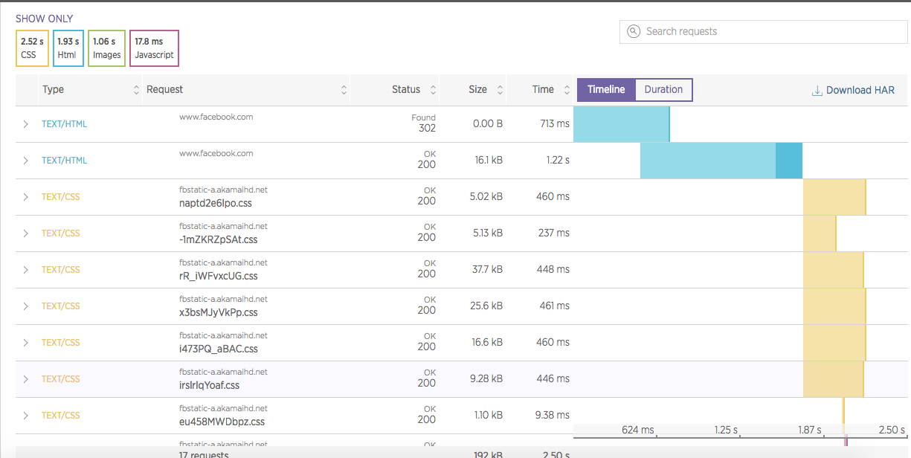
Unfair advantages
Beautiful UI
New Relic is relentlessly focused on delightful UX (our waterfall
visualization, for example)

Slide 16
Personas / Benefits
Ops / Dev-ops | Front end developers | App owners / Product managers | QA
Cares about: Performance, availability | Cares about: Functionality, performance | Cares about: Availability, functionality, performance | Cares about: Functionality
Immediate notification of site outages | Immediate feedback if deployment introduces new bugs | Assurance that critical application paths operate 24/7 as expected | Assurance that critical application paths operate 24/7 as expected
Baseline performance metrics for applications | Finds bugs that don’t throw exceptions | Immediate feedback if deployment introduces new bugs | Immediate feedback if deployment introduces new bugs
Identify CDN / geographic performance issues | Reduces variables when debugging | Immediate notification of site outages | See exactly what users see when something fails

Slide 17
Product Walkthrough

Slide 18
Product walkthrough
Take it away, Sumita!
(And don’t forget the tutorial on setting up monitors)

Slide 19
Monitor Setup Challenge

Slide 20
Monitor Setup Challenge
https://synthetics.newrelic.com/accounts/458458/synthetics
And…. GO!

Slide 21
Synthetic Scripting

Slide 22
Synthetic scripting
Your turn, Raf.

Slide 23
Selling Synthetics

Slide 24
Elevator pitch
“New Relic Synthetics continuously monitors your application’s performance, availability, and functionality so you know when something goes wrong before your customers do.”

Slide 25
Talk Tracks
Is your site up and running right now?
Does it run consistently throughout the day/week/month?
How do you know your site works for users around the globe?
Do you know if it performs as well from Sydney as from San Francisco?
Do you want to know about issues with your site before your users do?
If a user DID get an error on your site, how would you know what they saw?
How do you make sure your API is working and performant?
Can you compare that to results from 6 months ago?
Do you know the baseline performance of critical paths through your site?
How does that change if you add a new JS widget to one of your pages?

Slide 26
Selling as Part of a Platform

Slide 27
Selling the Platform
We’re the only synthetics solution backed by a platform.
Let’s sell the shit outta that!

Slide 28
Selling the Platform
Platform effects
The thing about a platform is that as you add products to it, you start
getting extra benefits beyond what each of the products bring. It’s basically
a 2+2=5 situation.
Because of this, each additional product should be a little easier to sell
once you have your foot in the door with the first one.
Bring Synthetics into every deal
Synthetics is an integral part of the software analytics story. It
complements APM by testing the customer facing part of the application
compliments Browser by setting baseline performance metrics / reducing
variables when debugging, and compliments mobile by offering automated
testing of APIs behind mobile applications.

Slide 29
Selling the Platform
Synthetics as a foot in the door
Because Synthetics is frictionless to set up and plays well with competitors’
APM solutions, it’ an ideal product to introduce new customers to the
New Relic platform.
Getting started
To score that standalone deal that gets you in the door, focus on these:
- It’s frictionless to set up. We can have you up and running in 5 minutes.
- Ping checks are FREE! Tough to beat that value.
- We play nice with other APM solutions. Sure we don’t integrate with
them (you probably don’t have that anyway…) but, we’ll run just fine
alongside whatever you use today. Have I mentioned APM?

Slide 30

The Triforce
Synthetics
Browser
Insights

Slide 31


Synthetics + Browser
vs.
Synthetics is like a laboratory. We eliminate variables so you can get understand performance and solve problems quickly and easily.
Browser is a jungle of empirical data. Different browsers, devices and networks mean we can provide all the variation in technical and geographic data you could need.
(Spoiler alert: you need both!)

Slide 32
Synthetics + Insights
Designed as part of a platform
Synthetics was built to be part of a platform. It uses Insights for its data
storage and comes with 13 months of free data retention in Insights.
Leveraging this integration
Another reason that Synthetics is a perfect starter product for the NR
brand. Introducing customers to Synthetics automatically introduces them
to Insights - which only gets better as they plug in more products.

Slide 33
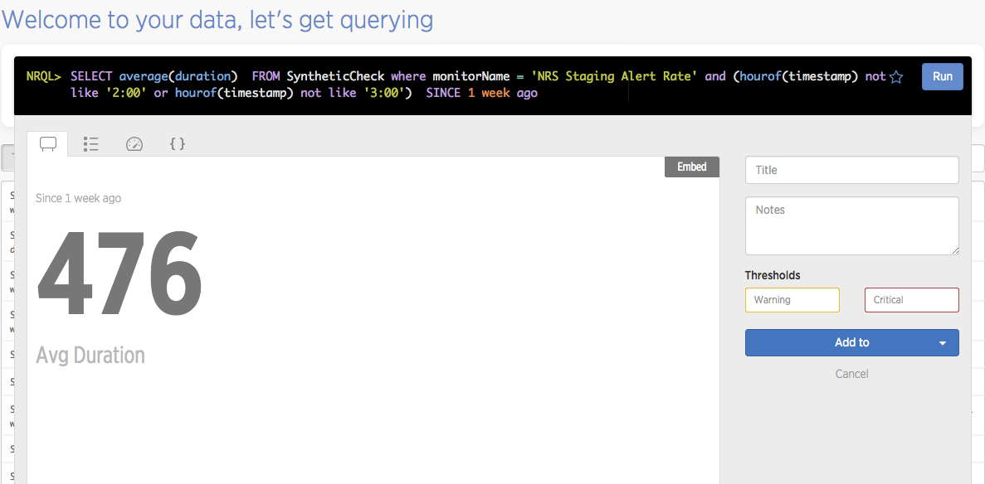
Synthetics + Insights
Deep understanding of performance
We can dig into data in ways beyond our competitors’ capabilities.
Example: Get performance data that excludes a certain time window.

Slide 34
Synthetics + Mobile
API Testing
Many mobile applications use APIs to transfer data to and from the app.
This means Synthetics scripted API monitors are a must-have for ensuring
availability and performance of the services that drive the app.
Works with hybrid too
Hybrid mobile apps include both native application code and calls to a
website. How do we make sure that web portion is always available? You
guessed it… Synthetics.

Slide 35
Synthetics + APM
Front to back understanding
Synthetics allows customers to follow their transaction all the way back
into APM. No matter the cause of the problem, Synthetics can catch it
and provide a full stack of analytics for diagnosis. That’s pretty powerful!
By the way
Gomez/Dynatrace have had all the pieces they need to do this for more
than 4 years, but somehow haven’t managed to make that happen yet.

Slide 36
Overcoming Objections

Slide 37
Feature Objections
Objection | Response
Alerting is not very robust / No alerting escalation | The new Alerts features that NR is rolling out allow you to create robust alerting policies across many different channels, including several escalation options like PagerDuty and VictorOps
Limited number of testing locations | We expect to roll out many more locations over the next year, but we’ll never have 100’s of them because that’s not necessary. RUM data will show you every location your users are coming from, so why pay for more checks than you need to ensure functionality and baseline performance?
No private locations | We’re building this RIGHT NOW!
Variable IPs make it hard to use with our security | We’ve got this on our roadmap for next quarter. In the mean time, private locations will probably solve this problem for you.

Slide 38
Feature Objections
Objection | Response
Too hard to create scripts | We have a 1st class script builder/recorder on our roadmap for next quarter. In the mean time, there is a 3rd party recorder (SE Builder) you could try.
No steps support | On the roadmap for next quarter.
No API | On the roadmap for next quarter
No load testing capability | We recognize load testing is important, but don’t think it belongs as part of a performance and availability analytics tool. Instead, we recommend BlazeMeter as a great product that works well alongside Synthetics.
Only simulates browser | Synthetics tools are not meant for cross browser testing! The market has duped customers into running more tests than needed for years. A better alternative for understanding all the versions/browser/device combinations is to use a RUM tool like Browser.

Slide 39
Pricing Objection
Woah! That’s a little too expensive. I just don’t see the value.
At some point, you’re going to hear this, so how do we fight it?

Slide 40
Pricing Objection
Front end vs. back end
In the old days of the web, back end development was more expensive and
time consuming than front end. With modern technologies, this has
inverted, but we’re still fighting old perceptions
Prove it
Look at the breakdown in rendering a web page. You’ll probably see that the
server is much faster than network time and browser rendering. This means
there’s more room to improve the front end than the back end, and therefor,
more value there.

Slide 41
Pricing Objection
You need how many monitors?!
Another opportunity to decrease cost is to challenge how many monitors a
customer thinks they need. Smart strategies for monitor creation and an
understanding of ‘effective frequency’ can reduce the cost considerably.
Who really benefits?
Synthetics benefits more than one team in most organizations. Isn’t a tool
that helps Ops, Engineers, and Product Owners demonstrating a fair
amount of value?
Platform effect
Where applicable, help customers see that they are getting even more value
by combining Synthetics with other parts of the New Relic platform.

Slide 42
Other Objections
Objection | Response
We already have a synthetic monitoring solution | NR Synthetics is the only synthetic testing tool that is part of a platform. We offer deeper analytics than our competitors, full HTTP headers, with simple and fair pricing. Plus, it’s easy to set up, so switching isn’t a burden.
We have a RUM solution already, so we don’t need Synthetics. | RUM and Synthetics each bring something to the party. RUM surfaces real user data has a lot of variables that create “noise” and interfere with diagnosing certain kinds of problems. Synthetics is like a laboratory. It removes variables so you can compare performance to an established baseline and diagnose problems more quickly.
Your product is too new. | New Relic has a track record of innovation and thought leadership with all our products. Our history of rapid development should suggest how quickly we will take this product beyond what our competitors offer. As validation, we have already started selling into several large enterprises.

Slide 43
Tell a New Story
NR Synthetics is a young product
Some of our competitors have been doing this longer than us and have
more features than we do right now, but none of them have a platform.
Avoid feature fights. Sell the platform.
Don’t get into feature fights with our competitors. Instead, change the
conversation. Point out the benefits of integrating with a platform.
New Relic = Innovation
Despite being newer to market in this space, New Relic has a record of
innovation. Our competitors… not so much.

Slide 44
Overcoming Competitors

Slide 45





How we stack up
Deep analytics including individual assets and HTTP headers | Analytics don’t go as deep; limited asset charting | Analytics don’t go as deep; limited asset charting | No waterfall chart | Analytics don’t go as deep
Software analytics product suite – a single pane of glass through app delivery cycle | Exists but limited; suite built through acquisition | Exists but limited; suite built through acquisition | No software analytics suite | No software analytics suite. No APM.
Simple & fair pricing | Pricing is complicated and more expensive | Pricing is complicated and more expensive | Ultra low cost. Limited features. Availability monitoring is not free. | No pricing data available. Still gathering intel.
70% of the market, privately owned by Thoma Brava

Slide 46
vs
What they say | What we say
We're the market leader is Synthetics and have been for 10 years | And they haven’t innovated in about as many years.
We have a really good script recorder | You still have to edit your scripts, and they are written in an obscure language your developers are unlikely to know. New Relic uses Selenium (the standard for automated browser scripting) and is developer friendly.
We support multiple browsers | Synthetics tools aren’t for cross browser testing! The market has duped customers into running more tests than needed for years. RUM is better for understanding all the version/browser/device combinations.
Depositioning Gomez
Takes more than 30 minutes to generate custom reporting, and only retains 1 week of data. New Relic does a better job using Insights… in 30 seconds… with 13 months of data.
Doesn’t integrate well with their APM or offer any HTTP header data
Aren’t they owned by the same investment firm as Keynote? Will Gomez even continue to exist in another year or two?

Slide 47
vs
What they say | What we say
We're a market leader is Synthetics | And just look how much innovation that has brought about in their product.
We have a mobile solution as well as our synthetic testing | We have a mobile solution, too… and an APM solution… and advanced reporting through Insights… and they all work together because they’re all part of a PLATFORM.
We have consumption based pricing so you only pay for what you use | How can you predict what you’re going to spend with such a complex pricing model?
Depositioning Keynote
Doesn’t offer deep dive analytics or HTTP header data and only has limited asset charting
The monitor that cried wolf - they generate a ton of false positives that result in alert fatigue.
Consolidating all your performance analytics to one platform/vendor has synergistic benefits, but simply isn’t possible with Keynote.
Monitors are a pain to set up or edit.

Slide 48
vs
What they say | What we say
We’re less expensive | They charge for simple availability monitoring - we don’t. Tell me again how they’re cheaper?
We’re simpler to set up | This just isn’t true. New Relic is at least as easy to set up as Pingdom, and we back our solution with a whole platform of extra capabilities.
We’re more experienced in the Synthetics market | Then why does our product offer deeper analytic capabilities, better visualizations of data, and integration with our APM solution?
Depositioning Pingdom
Pingdom is an entry level tool that doesn’t offer any deep analytics or integration with APM
They have very limited functionality and scripting options and don’t offer any kind of screen shot when monitors encounter an error
Pingdom’s visualizations are rudimentary. They don’t even provide a waterfall chart for their checks.
They trade on their low pricing, but they charge for features NR gives away for free (I really want to emphasize this one).

Slide 49
vs
CatchPoint is a new kid on the block. We don’t have much intel on them yet, but they’re worth mentioning because they’re doing a few things well.
Generally speaking, here’s how to position against them:
- CatchPoint is a point product.
- They do a few things right, but generally lack the power of a platform or
even a significant suite of products to back them up.
- Insights offers more robust data analysis than CatchPoint offers.
Be careful. There are a few places they can try to beat us:
- They offer 2 years of data retention (vs our 13 mo.)
- They offer steps support (we’re building it next quarter)
- They offer video of synthetic page loads

Slide 50
Break
15 minute break

Slide 51
Successes & Challenges

Slide 52
Share your story
Let’s talk about success and challenges from the field
What have we learned? What could we do better?

Slide 53
Did you know?
A monitor can point at any site… not just your own. This means you can gather intel on your competitors’ performance and compared it to yours
You can use a scripted API monitor to query Insights and alert based on data stored there
You can spoof a different browser (even a mobile browser) by changing the agent header with Selenium
AppD doesn’t offer a synthetic testing solution. They’ve announced one, but it could take them up to a year to deliver
Sumita has figured out how to convert some Gomez scripts to run in NR Synthetics and that is something expert services can do for customers.

Slide 54
Coming Soon
Disclaimer: Software is hard! These are our best guesses,
but we don’t really know when (or if) we’ll build this stuff.
Quarter 1
Private minions
Alerting integration
Quarter 2
Better script creation
Steps
More locations
Static IPs
API

Slide 55
Q&A
???

Slide 56
Thanks for coming.
You’re all EXPERTS now!!!

